Slide 1
(MACHINE) LEARNING
Supervised Learning, Regression and Classification with Linear models, neural networks, support vector machines, ensemble learning

Slide 2
Learning from Examples
Machine learning is defined as the field of study that gives computers the ability to learn without being explicitly programmed.
Learning involves acquiring knowledge or skills from experience or data.
The 3 main forms of learning include supervised, unsupervised, reinforcement learning.

Slide 3
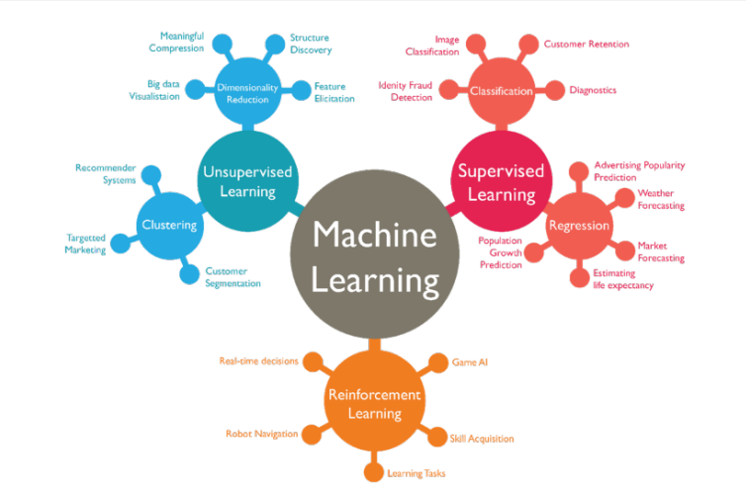

Slide 4
Supervised Learning
In supervised learning, we are given a data set and already know what out correct output should look like.
We use a set of variables (or features), denoted as X, to predict an outcome, Y.
Supervised learning problems are classified into “regression” and “classification” problems

Slide 5
Supervised Learning
In a regression problem, we are trying to predict results within a continuous output.
Example: predicting the price of a house given its dimension. The price has a continuous range of values.
In a classification problem, we are instead trying to predict results in a discrete output.
Example: predicting the type of breast cancer (malignant or benign) given the tumor size

Slide 6
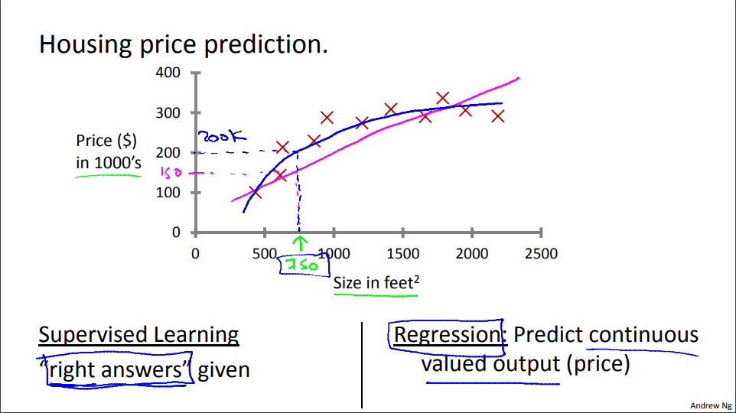

Slide 7
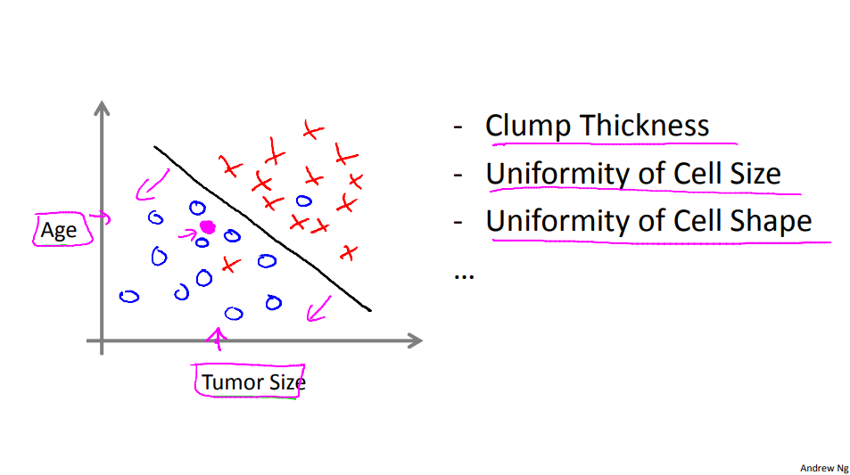

Slide 8
Supervised learning – Refresher
You’re running a company, and you want to develop learning algorithms to address each of two problems.
Problem 1: You have a large inventory of identical items. You want to predict how many of these items will sell over the next 3 months.
Problem 2: You’d like software to examine individual customer accounts, and for each account decide if it has been hacked/compromised.
Should you treat these as classification or as regression problems?

Slide 9
Supervised learning – Linear Regression
The goal of linear regression is to “fit” a linear equation to a data set.
Fitt

